Slide 1

Managing Feedback
Turning Criticism into Constructive Growth

Slide 2
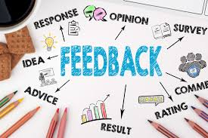
What is Feedback?
Feedback is information given to someone about their performance, behavior, or work.
It can be verbal or written, formal or informal.
Purpose: To help a person or team improve, grow, and understand how others perceive their actions.
Example: “A teacher telling a student how to improve their assignment” or “Your manager giving comments on your recent project.”

Slide 3
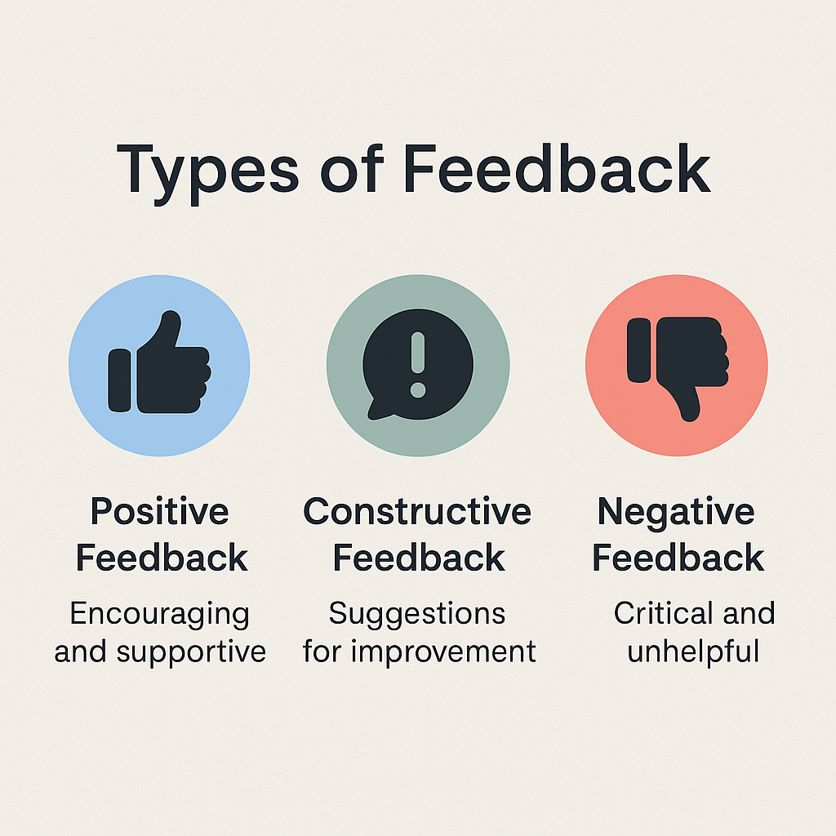
Types of Feedback
1. Positive Feedback
Encouraging and appreciative
Builds confidence
Example: “Great job on the presentation. Your visuals were very clear!”
2. Constructive Feedback
Suggests improvement while being respectful
Focuses on how to do better
Example: “The content was good, but speaking a bit slower would help the audience follow better.”
3.Negative Feedback
Often blunt or harsh
Can demotivate if not given carefully
Example: “This was a bad report—you didn’t even follow the format.”

Slide 4

How to Give Effective Feedback
Be specific – Don’t just say “good job,” say why it was good.
Focus on actions, not the person – “The project lacked structure” instead of “You’re disorganized.”
Use the Sandwich Method:
Start with something positive
Give constructive suggestions
End with encouragement
Give feedback soon after the event – timing matters.
Be empathetic and respectful

Slide 5

How to Receive Feedback
Listen fully before responding.
Don’t take it personally – focus on the message, not the tone.
Ask questions like: “Can you give me an example?” or “How can I improve that part?”
Reflect before reacting.
Take action on helpful feedback to show growth

Slide 6
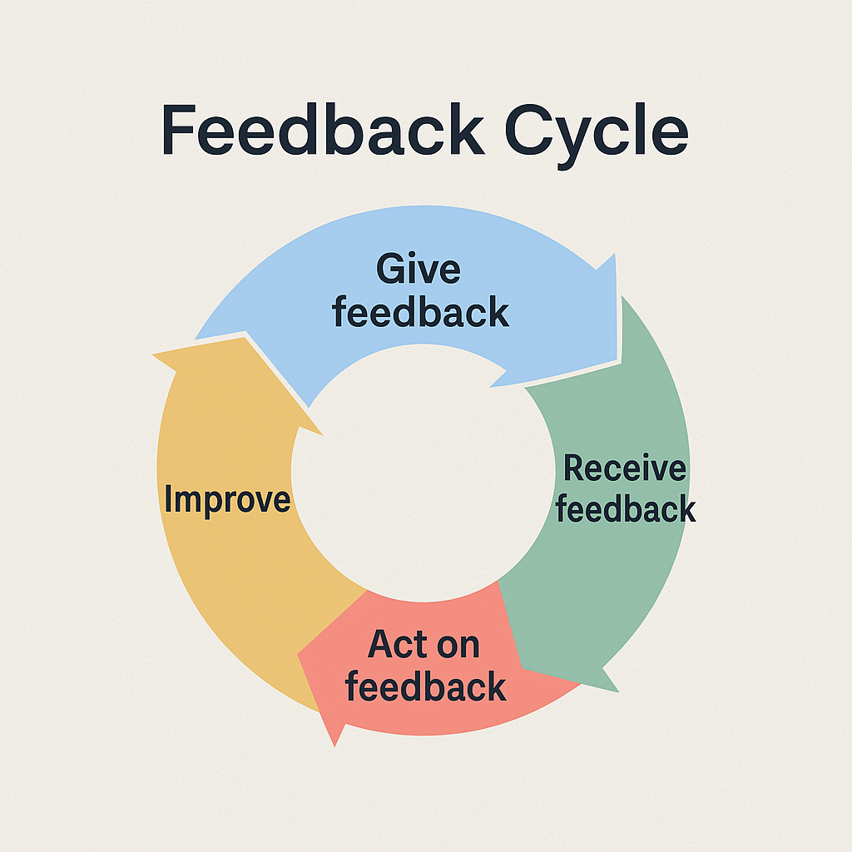
The Feedback Cycle
Give feedback → Share thoughts or suggestions.
Receive feedback → Understand and reflect.
Act on feedback → Apply it to improve.
Improve → Show better results.
Loop continues → Continuous development.

Slide 7

Feedback in Different Settings
Workplace:
Performance reviews
Project evaluations
Team communication
Education:
Teacher to student (grades, comments)
Peer reviews (group work)
Customer service:
Customer feedback on services/products
Ratings and reviews

Slide 8

Best Practices for Managing Feedback
Create a safe space for open feedback.
Allow anonymous feedback when necessary.
Make feedback a two-way process.
Don’t ignore feedback – follow up and show action.
Recognize and celebrate improvements.

Slide 9
Tools & Techniques
Digital Tools:
Google Forms
Microsoft Forms
SurveyMonkey
Techniques:
Suggestion boxes (physical or digital)
One-on-one check-ins
Group feedback sessions
360-degree feedback (from peers, subordinates, superiors)

Slide 10
Benefits of Managing Feedback Well
Improves personal performance
Strengthens communication
Encourages continuous learning
Builds trust and collaboration
Helps reach goals faster and more effectively

Slide 11
Conclusion
Key Takeaway: Feedback is not criticism—it's an opportunity to grow.
Embrace feedback with an open mind.
Ask for it regularly, give it wisely, and act on it consistently.
"Feedback is the breakfast of champions." – Ken Blanchard

Slide 12
Thank you

